Slide 1
HR Data Analysis
Year = 2000-2020

Slide 2
About Dataset
HR Analytics can provide valuable insights and benefits to organizations in many different areas, from talent acquisition and retention to workforce planning and diversity and inclusion. By leveraging HR Analytics, companies can gain a competitive advantage by developing data-driven strategies that help them attract and retain top talent, improve employee engagement and performance, and foster a positive and inclusive workplace culture.
This particular dataset holds 13 columns and 22,214 records. The 13 columns has information like their name, birth date, race, what department they work at, their job title, remote/HQ, hire date, term date, city and state.

Slide 3
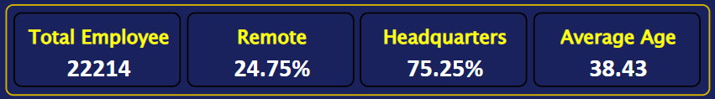
Create KPI’s that list the number of employees, percent of workers working remotely and in HQ and the average age.
Total Employee of company = 22,214
Active = 20482
Terminate = 1732
Total Remote Employee of company = 5499
Total Remote Employee of company = 16,715
Average Age of Employee = 39

Slide 4
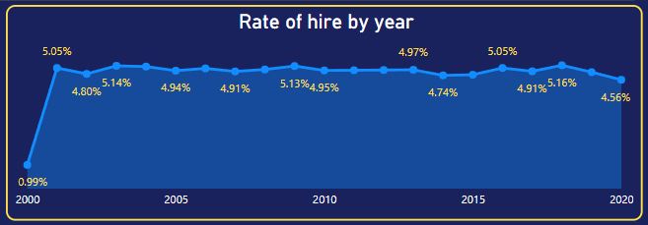
2. Create a Line chart showing the hiring rate By Year.
High Hire Rate in Year of 2018
Lower Hire Rate in Year of 2000 than following 2020

Slide 5
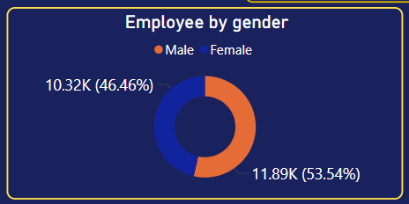
3. Create a Donut chart representing the gender of employees.
Male Employee = 11893
Female Employee = 10321
Male Employee more than Female Employee.

Slide 6
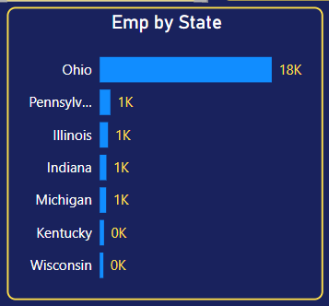
4. Create 3 Bar charts showing employees By State, By
Department & By Race.
State
Highet Employee From Ohio State = 18025
Lowest Employee from Wisconsin State = 382

Slide 7
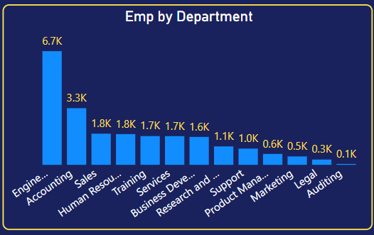
Department
Highet Employee From Engineer Department = 6686
Lowest Employee from Auditing Department = 52

Slide 8
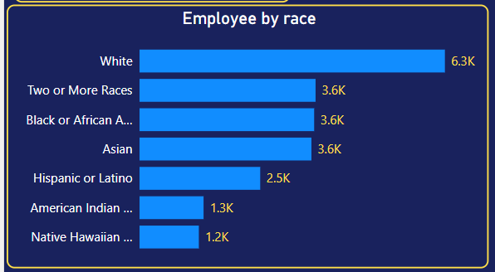
Race
Highet Employee From White Race = 6328
Lowest Employee from Native Hawaiian or other Race = 1239

Slide 9
Data Visualize in Power BI

Slide 10
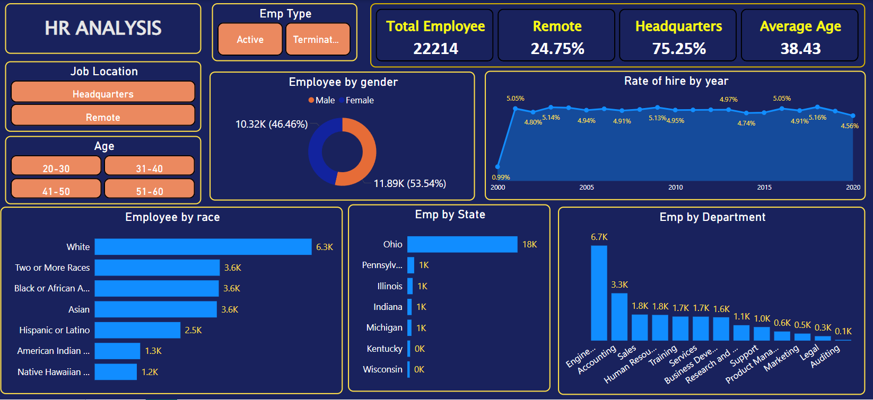

Slide 11
Data Insights and Suggestions

Slide 12
Active Employee
Terminated Emp
KPI
Metrics | Value
Total Employee | 20482
Total Remote Emp | 5089
Total Headquarter Emp | 15393
Average Age | 38
Metrics | Value
Total Employee | 1732
Total Remote Emp | 410
Total Headquarter Emp | 1322
Average Age | 39
Total Active Employee is 20482.
24.85% Employee work remotely.
75.15% Employee work in Headquarter.
Avg age of active employee 38.
Total Terminated Emp is 1732.
23.67% Employee work remotely.
76.33% Employee work in Headquarter.
Avg age of Terminated emp 39.

Slide 13
Gender
Male Emp = 9830
Female Emp = 8455.
No more difference between males and females.
Male are more than female so motivate female and hire more female.
Department
Top Department are Engineering (5.5K) and Accounting (2.7K).
Legal and Auditing have less employee.
Get trains Engineering department emp and Accountant for better performance.
Male Hire more in Legal, Auditing and HR if needed.

Slide 14
State
Ohio with 18025 employee top position.
In Pennsylvania 1115 employee work.
Other state have less than 1000 employee.
Most employee work in Ohio because almost 75% employee work in Headquarters. and Headquarters located at Ohio.so, hire remotely employee in other state.
Start office in other states and hire work from office employee.
Race
Company have highest employee from wight race and two or more Race.
There’s some mix of race, but you can work more on diversity and inclusion.

Slide 15
Hiring Trend
Highest hiring was in 2018 and 2003.
Lowest hiring was in 2000 and 2020.
Company hiring rate was almost consistence in every year its shows that the company grow up every year.
Hiring has dropped recently. Try new ways to attract people, like job fairs or online platforms.
Job Location
Almost 75% Employee work in Headquarters and almost 25% employee work remotely.
Remote work is only 25%. You can find good talent by offering more remote jobs.

Slide 16
Terminate
Total terminated employee = 1732.
High terminate in year of 2019.
Employee will terminal to 2041 = 2197.
Hire employee as per terminate.
Age
Average Employee Age is 38 year.
Hire some young employee for new energy and for succession planning.

Slide 17
Thank You

